Slide 1

Forests 2020:
Cloud Masking
Presented by
IPB

Slide 2
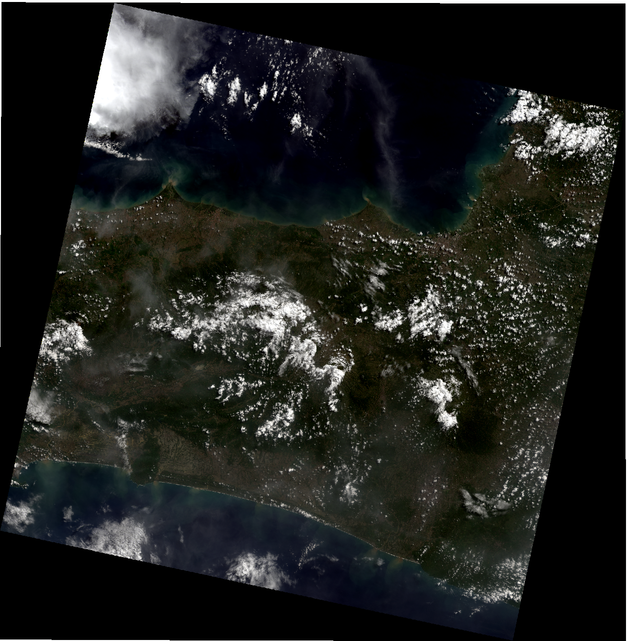
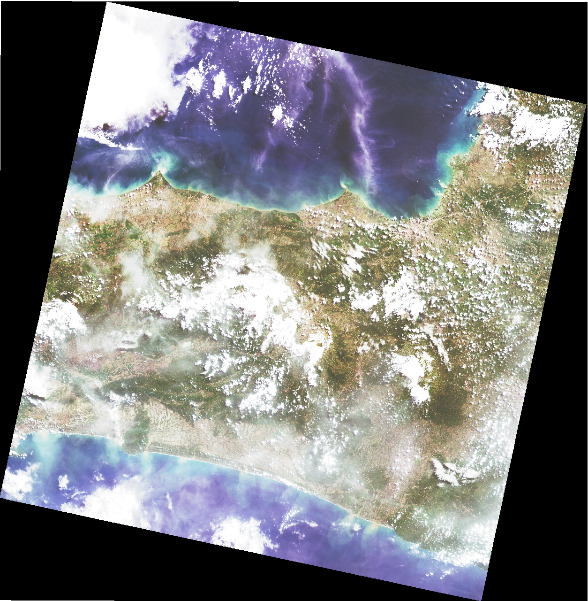
Cloud Masking
Band 432
Enhancement

Slide 3
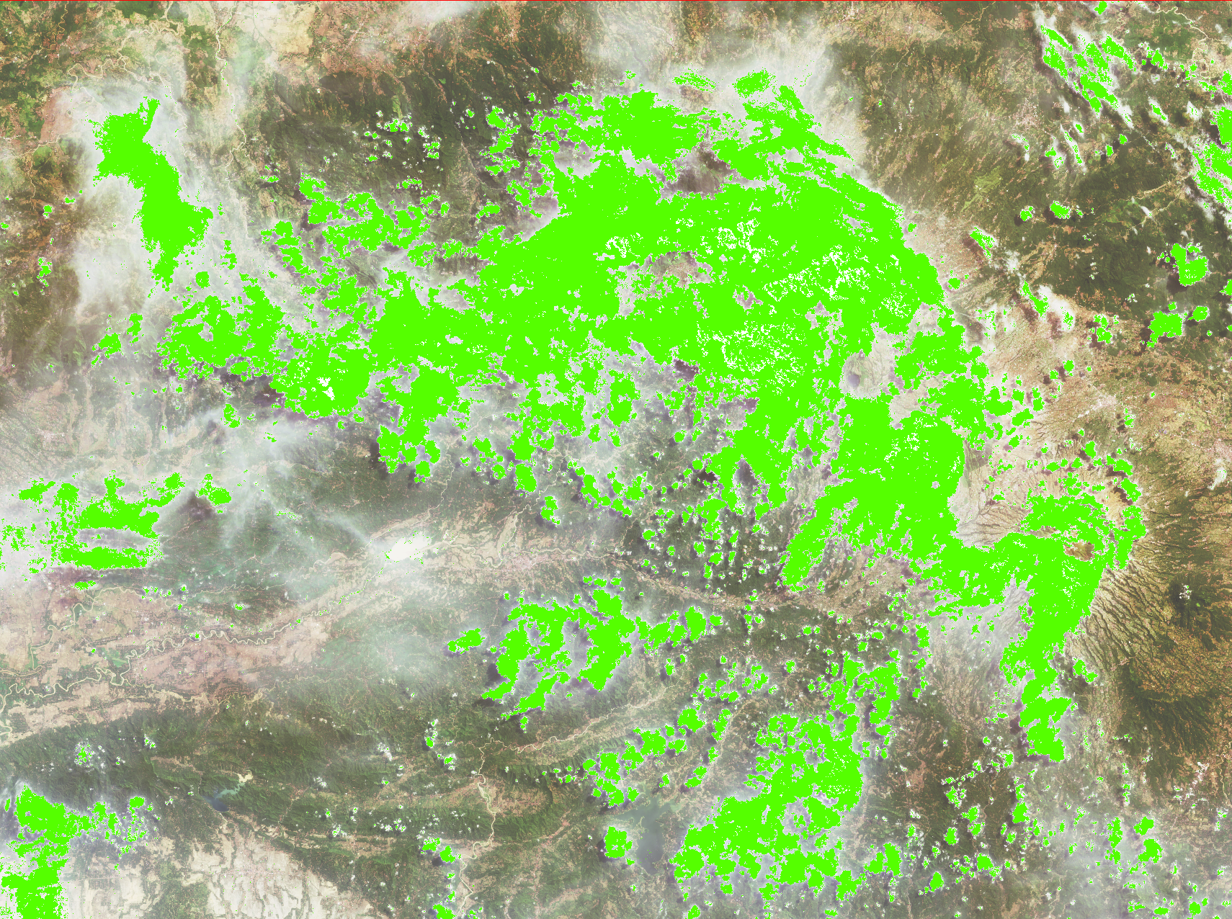
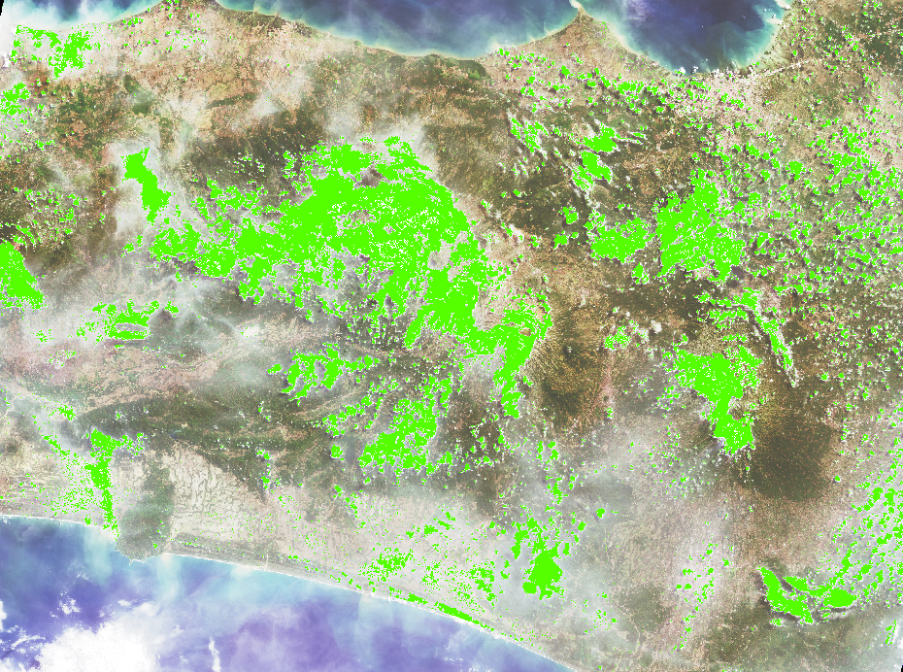
Band BQA

Slide 4
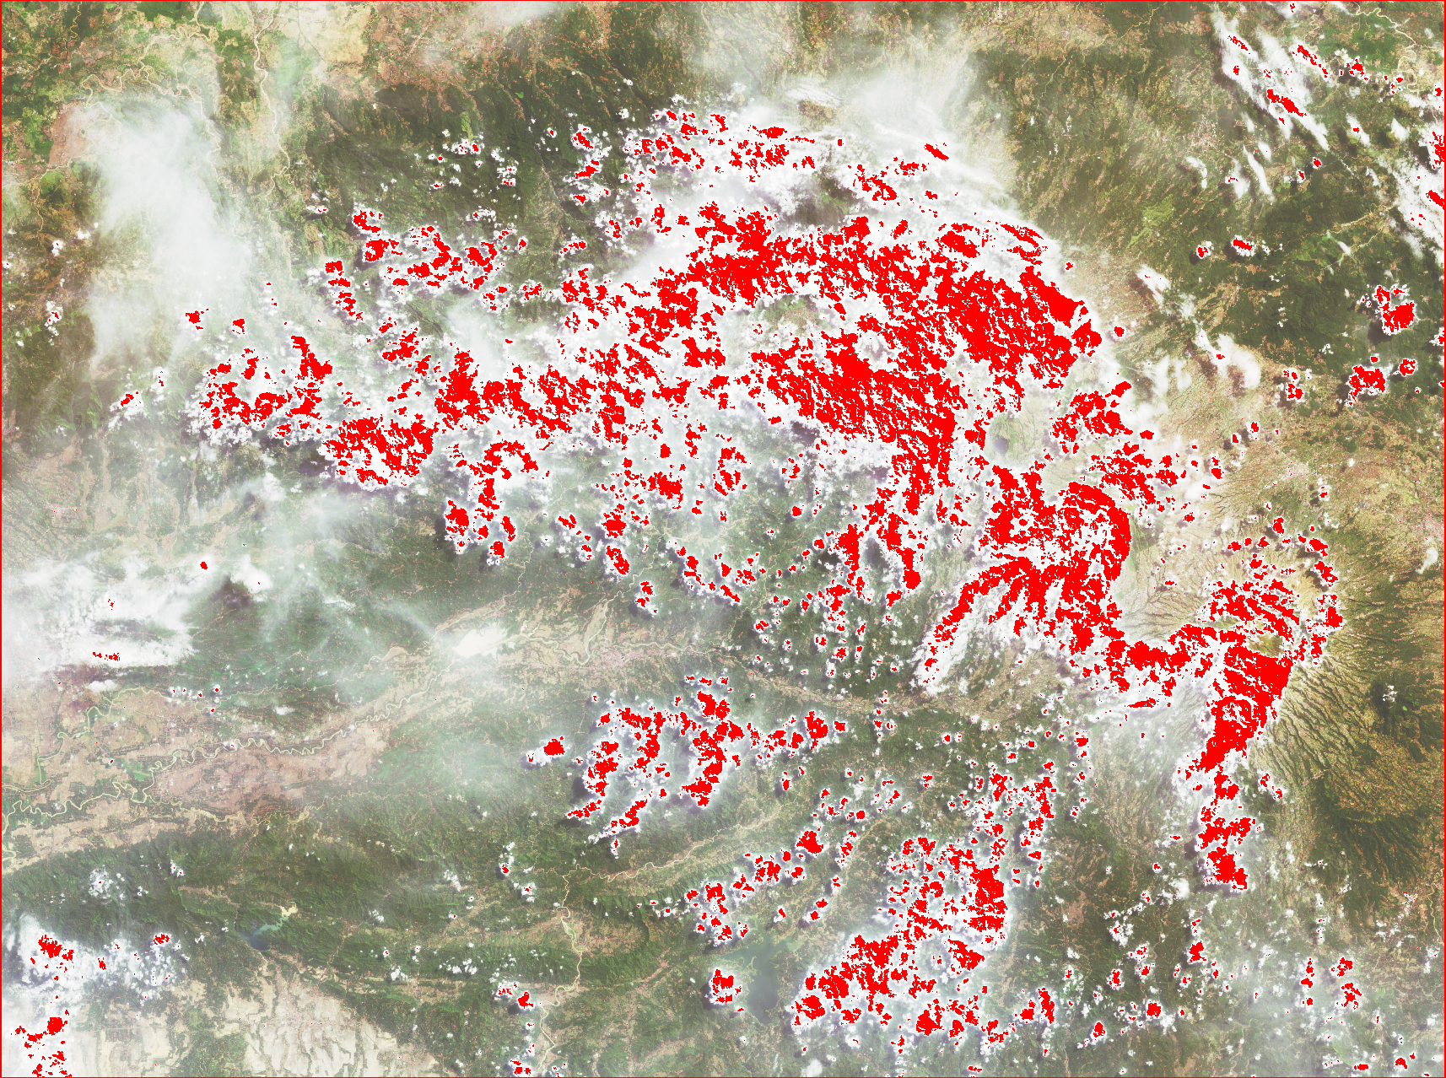
FMASK
BQA
FMASK

Slide 5
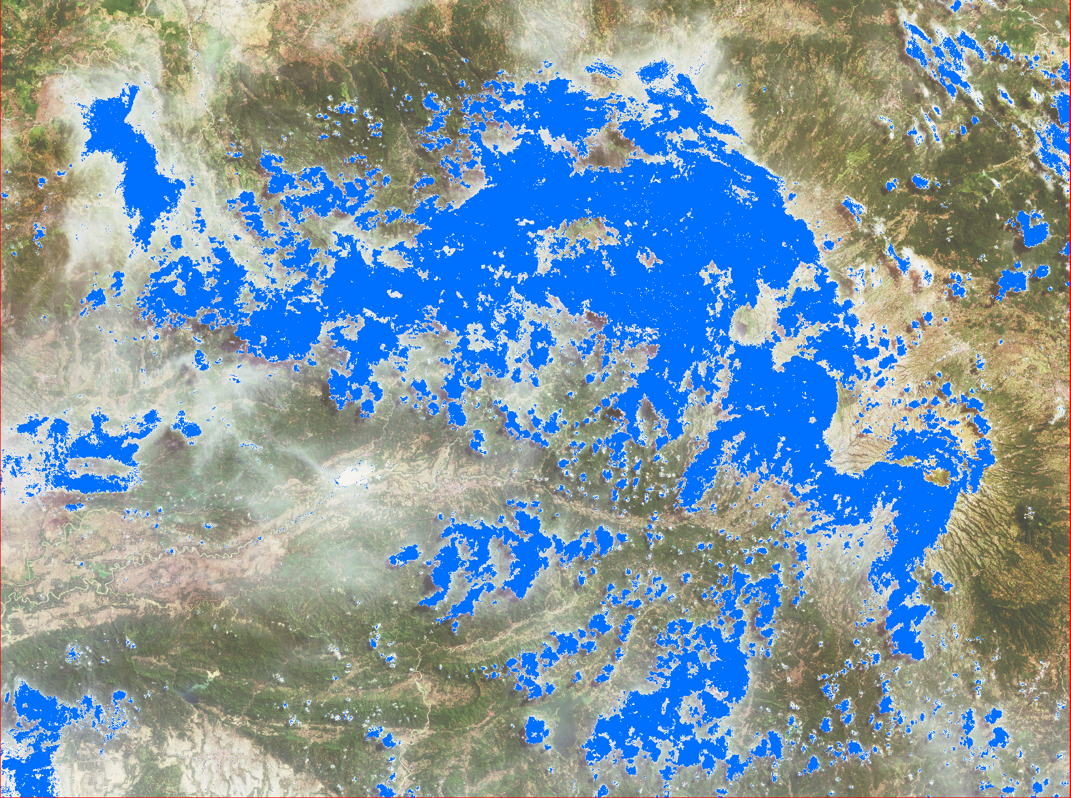
Combining FMASK & BQA

Slide 6
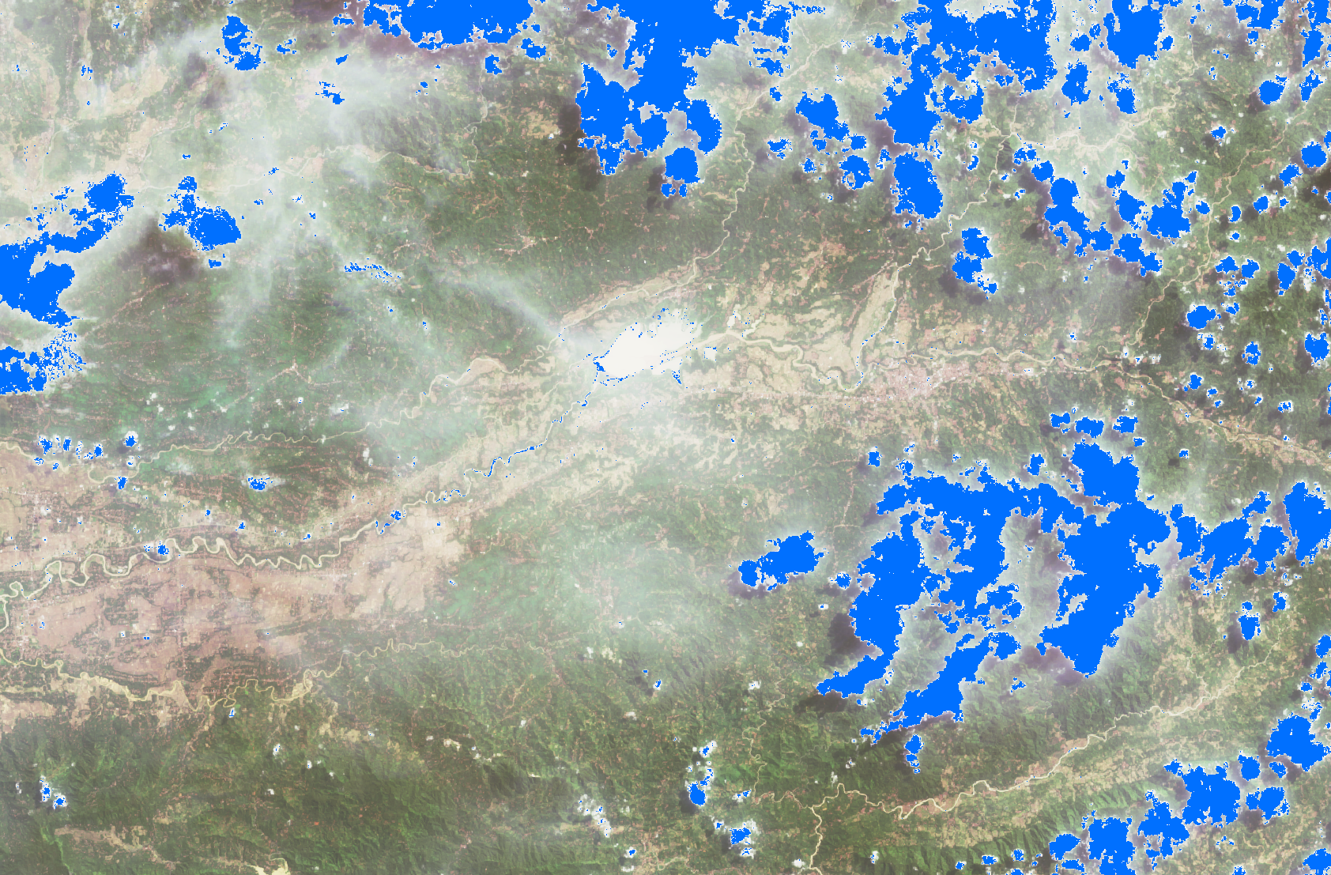
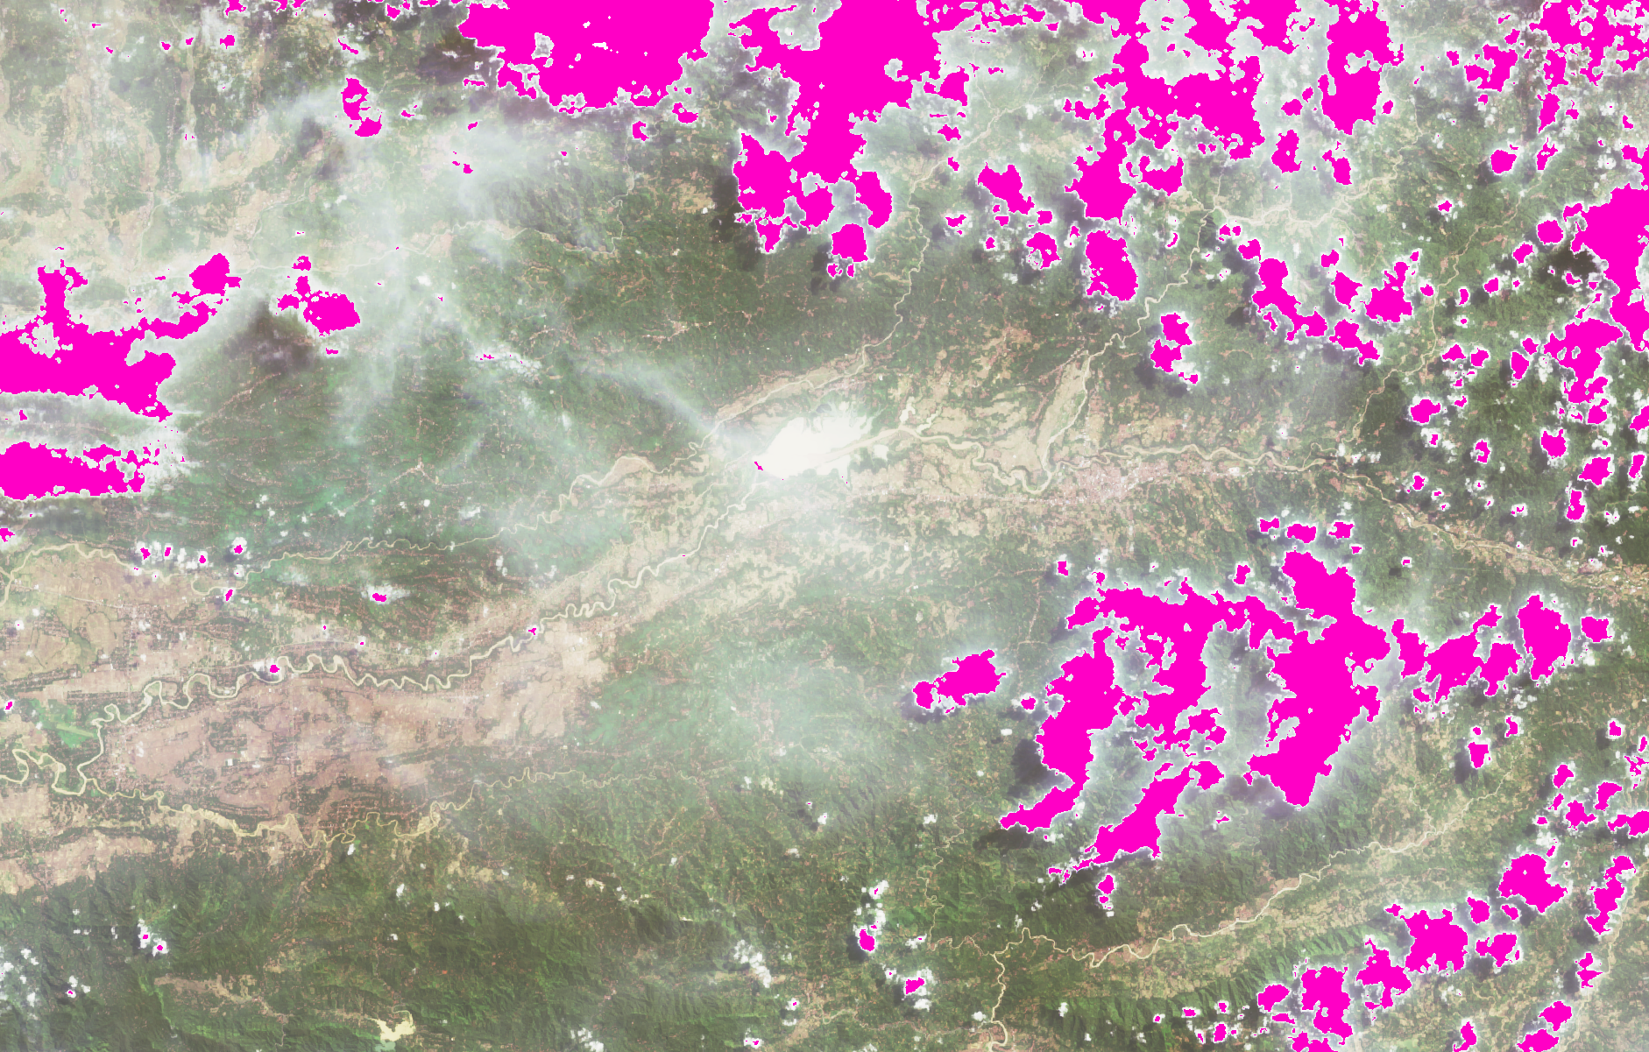
Cleaning
Original
After Cleaning

Slide 7
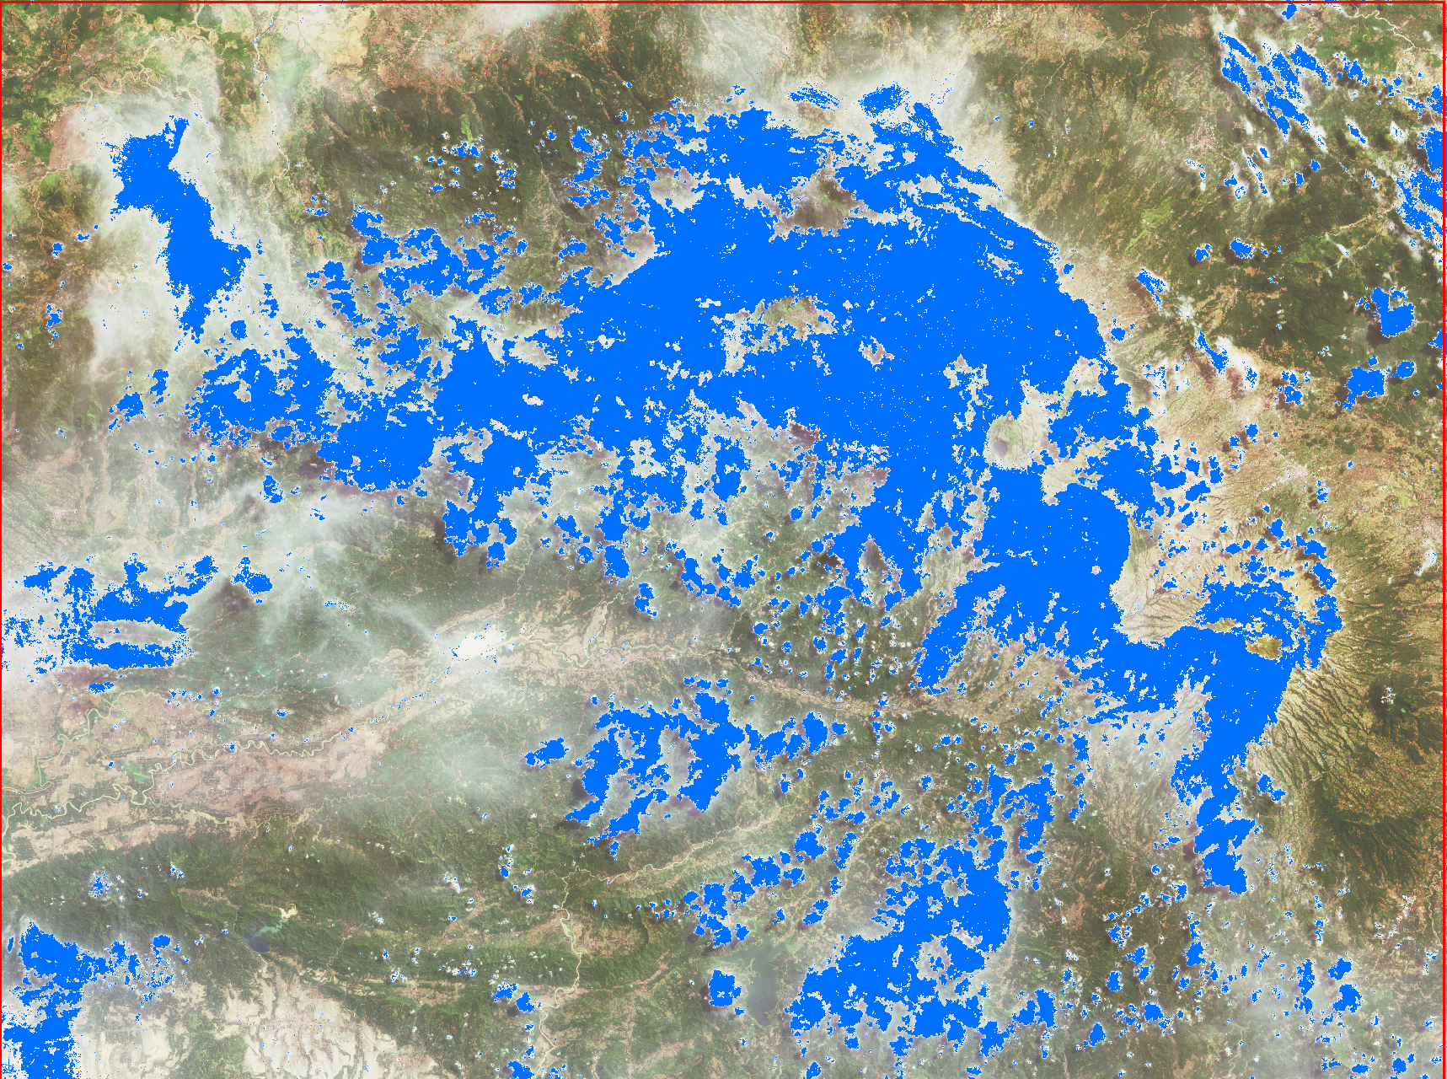
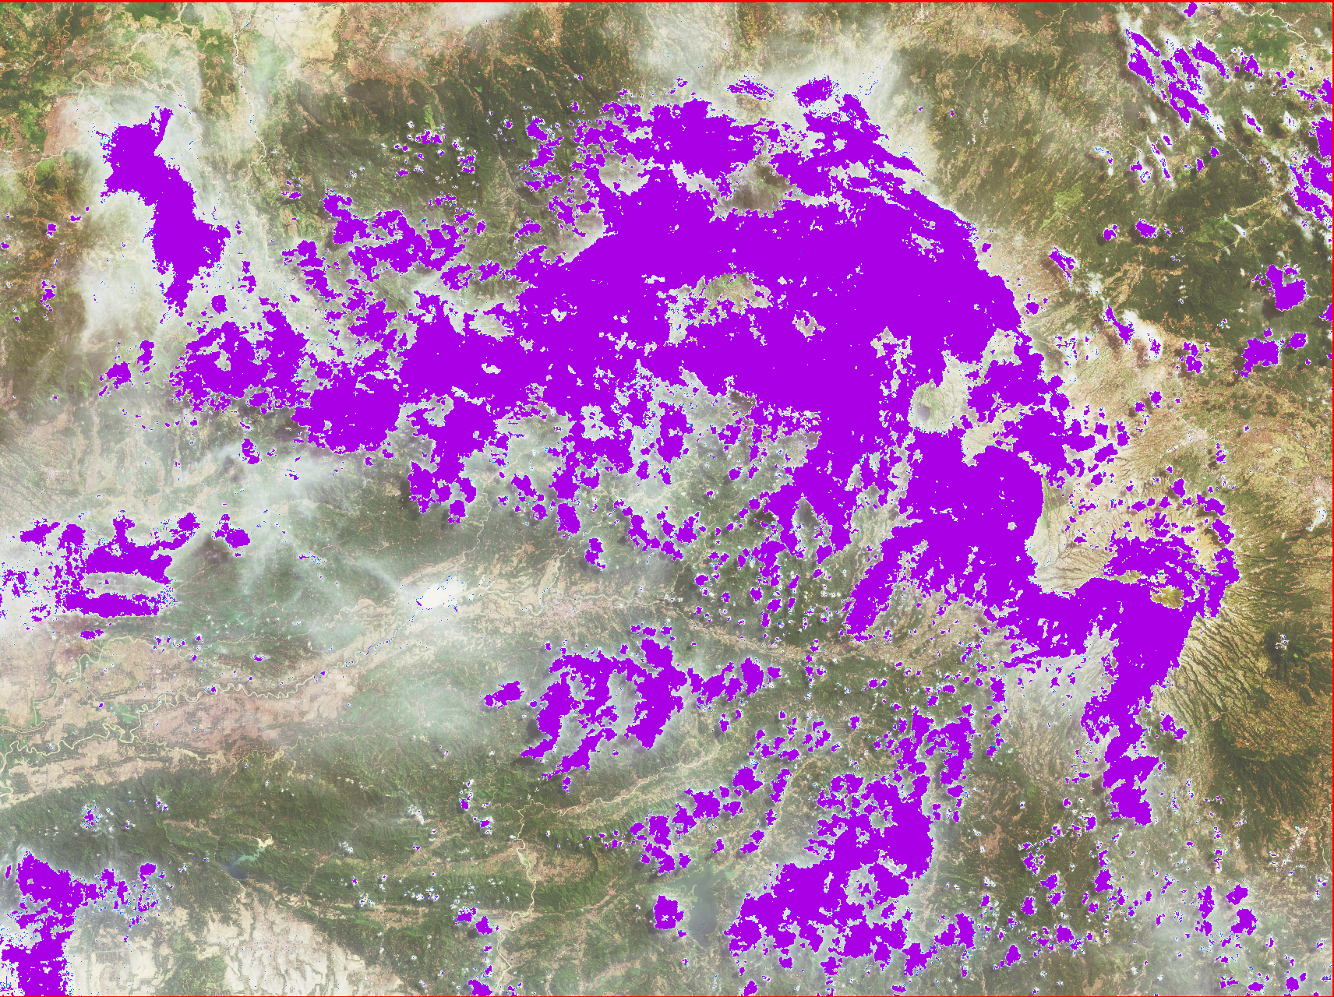
Median filter
BQA & FMASK
Median Filtering

Slide 8
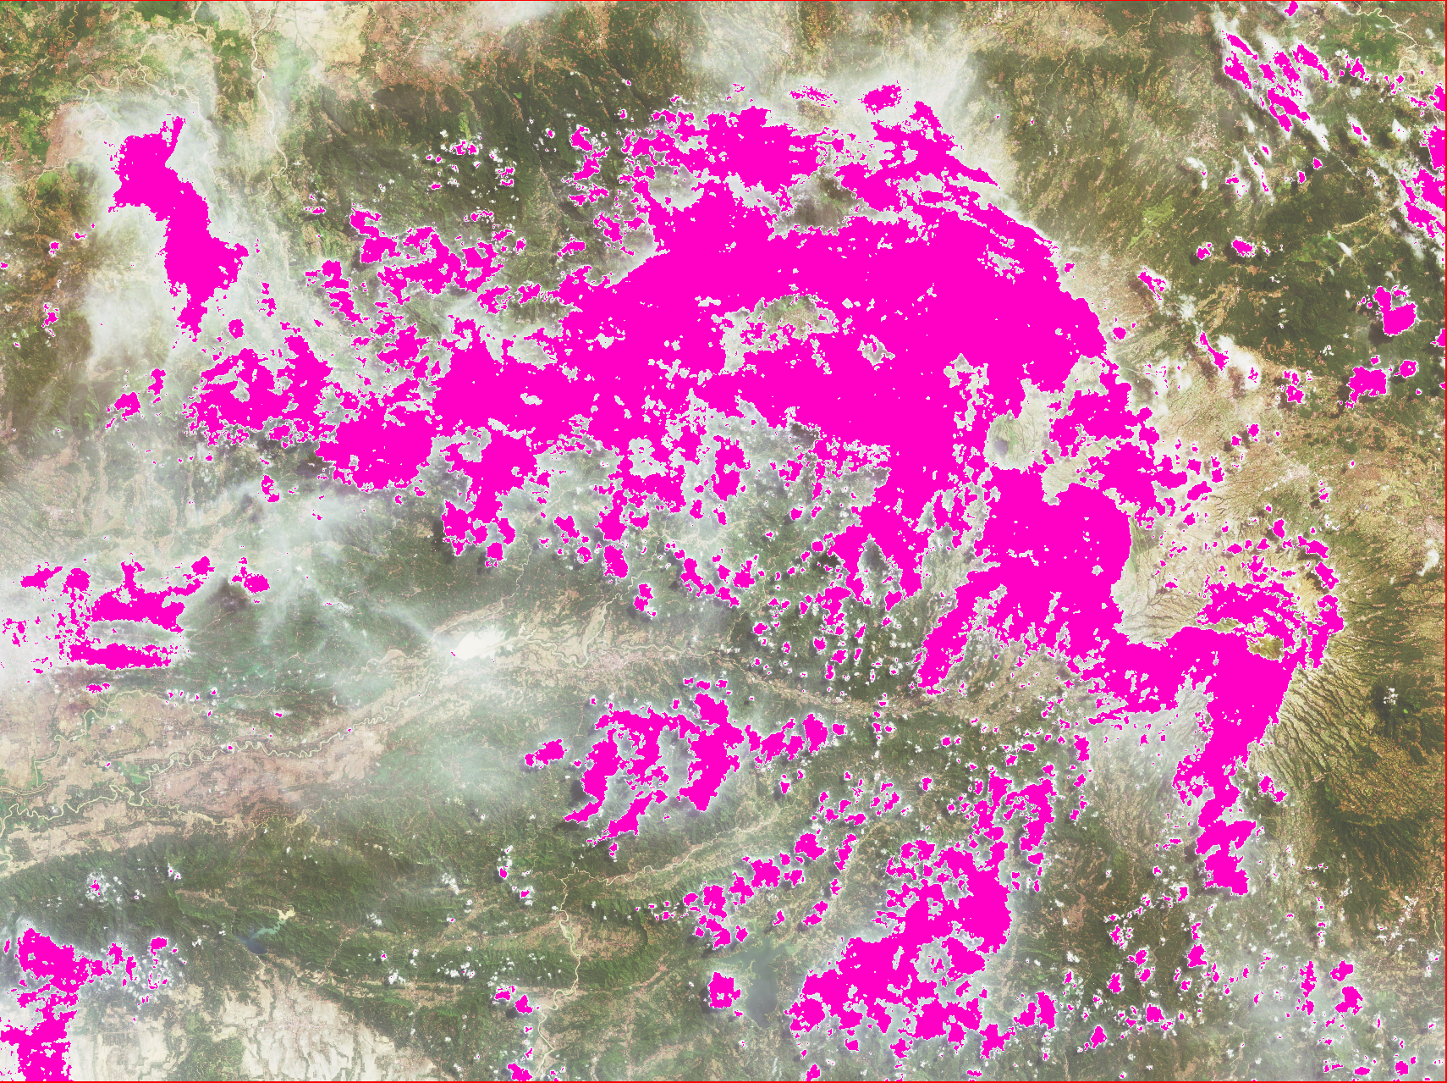
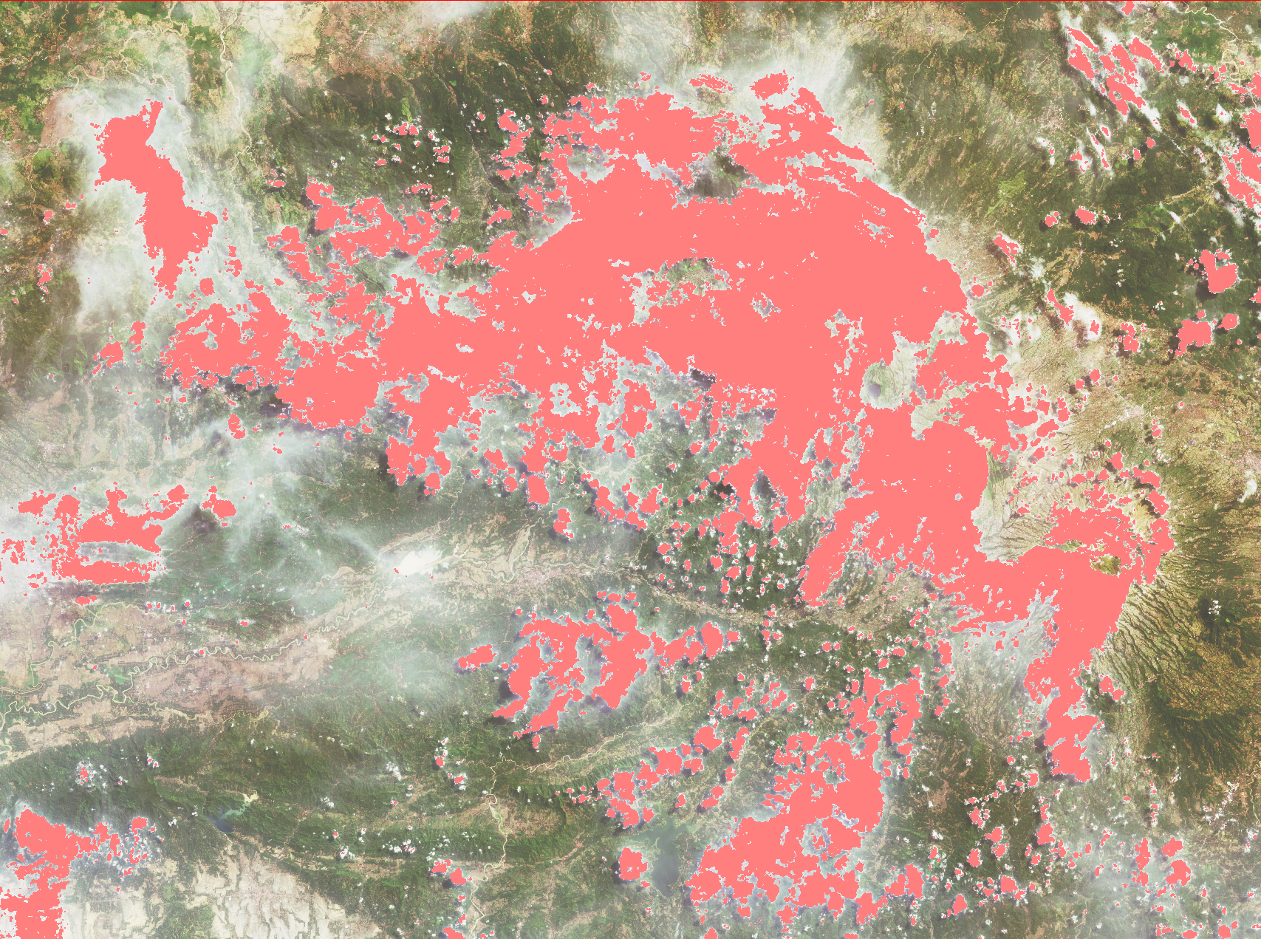
Buffering
Median Filtering
Buffering 2 pixels

Slide 9
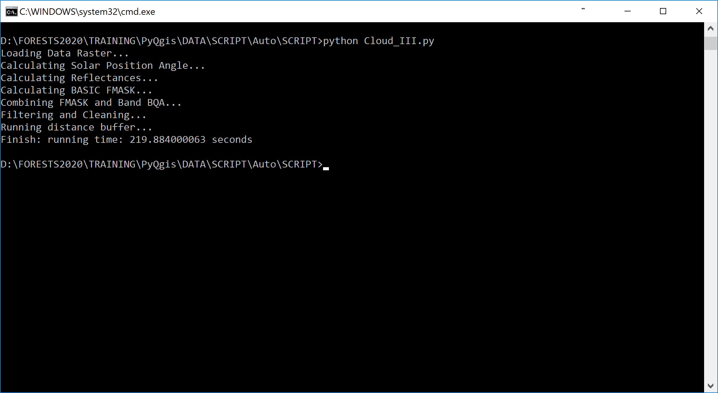
Running Time
Specification of Dell xps 13
Core i7 -7Y75 @1.30GHz
RAM 16GB

